Slide 1
Archival Description at a Crossroads
SAA Research Forum
Jodi Allison-Bunnell, AB Consulting, author and research analyst
Adrian Turner, California Digital Library, editor and project director
Notes:
Thanks for introduction
Pleased to speak today about our research on the state of archival description in aggregation

Slide 2
Project Overview
Archival description (finding aid) aggregation developed over last twenty years
What is the state of aggregation? We think that many aggregators are struggling to update their platforms and to engage with some of the most promising advances in the field
Could large-scale collaboration create efficiencies, increase effectiveness for end users and participants, and be more sustainable?
“Toward a National Finding Aid Network”
Planning grant funded by California State Library LSTA program to the California Digital Library
2018 October-2019 September
Notes:
This is part of. The Toward a National Finding Aid Network project, or NAFAN
Last twenty years….

Slide 3
Project Partners
Aggregators
Archival Resources in Wisconsin
Arizona Archives Online
California Digital Library (Online Archive of California)
Chicago Collections Consortium
Connecticut Archives Online
Empire Archival Discovery Cooperative (EADC)
Orbis Cascade Alliance (Archives West)
Philadelphia Area Consortium of Special Collections Libraries (PAARP)
Rhode Island Archives and Manuscripts Online
Texas Archival Resources Online
Virginia Heritage
University of Nebraska Consortium of Libraries
OhioLINK (OhioLINK Finding Aid Repository)
Rocky Mountain Online Archive
Meta-Aggregators
OCLC Research (ArchiveGrid)
National Library of Medicine (History of Medicine Finding Aids Consortium)
Social Networks and Archival Context (SNAC)
Notes:
Also ack Archives Florida, NC ECHO as defunct networks
individual profiles of Yale, Harvard, the University of Washington, and Oregon State University

Slide 4
Expert Advisers
Christine di Bella, ArchivesSpace
Mark Matienzo, ArcLight Project
Clifford Lynch, Coalition for Networked Information
Michele Kimpton, Digital Public Library of America
Roger Schonfeld, Ithaka S+R
Mary Lacy, Library of Congress
Leigh Grinstead, LYRASIS
Don Waters, Mellon Foundation
Jerry Simmons, National Archives
Robert Horton, Smithsonian Institutions
Raym Crow, SPARC

Slide 5
Project Elements
Complete
Profile of finding aid aggregation in the United States and how it related to archival description and access
Full-day symposium with partners and advisers
In Process
Action plan for next phase of collaborative planning and implementation phases of future work
Notes:
The project has three elements…
For this forum, I’m going to focus on the profile as a significant piece of research in the field

Slide 6
Definitions
Aggregator: Program/organization that hosts or harvests descriptions of archival collections (mostly EAD finding aids) from institutions within a state or region.
Meta-Aggregator: Program/organization that harvests finding aids and/or descriptions of archival context from institutions nationwide, or beyond.
Notes:
Key definitions,
Why aggregation? Key questions are around next steps in aggregation. They also inform us substantially on the state of archival description and access in the US.

Slide 7
Profile of Aggregation Landscape

Slide 8
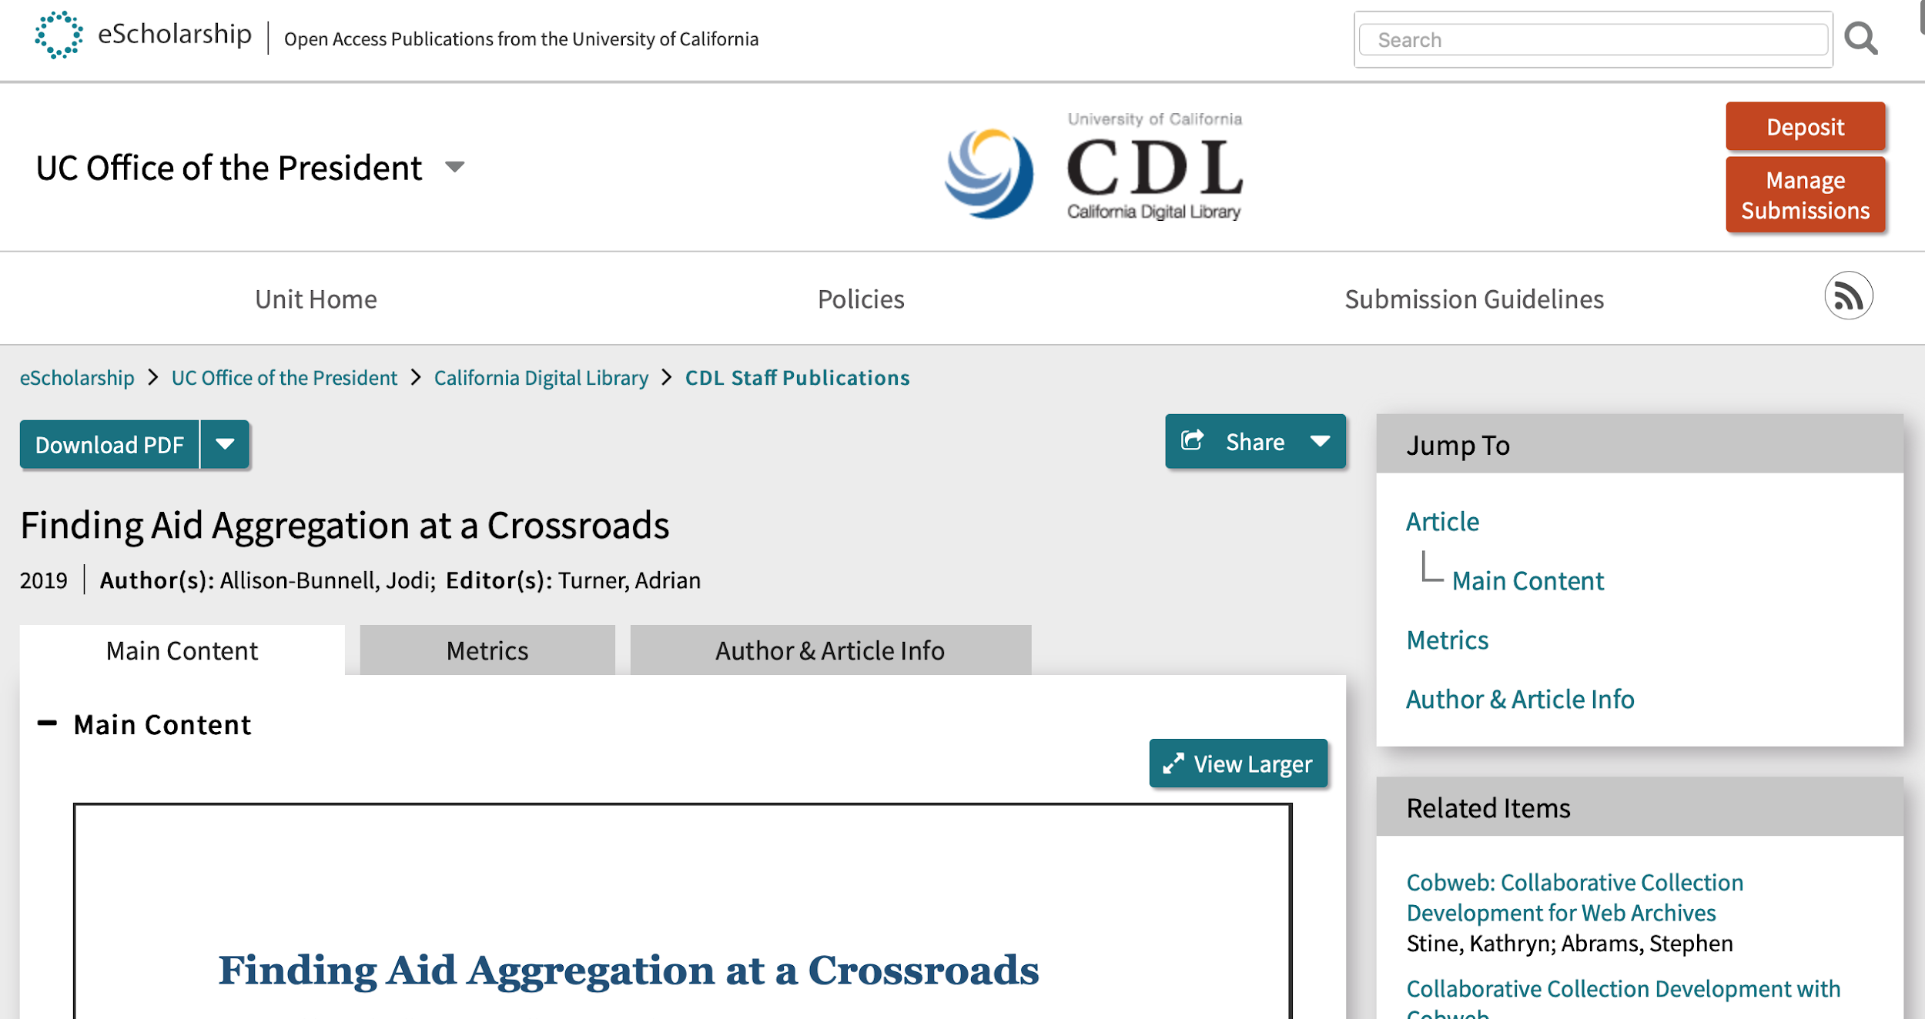
Finding Aid Aggregation At A Crossroads
In-depth surveys and interviews with all current and defunct U.S. state and regional aggregators and three meta-aggregators
Context of current archival description landscape
https://escholarship.org/uc/item/5sp13112
Notes:
We just posted a report titled "Finding Aid Aggregation at a Crossroads", which summarizes our findings
The report is linked from the project wiki -- and also directly available at this URL
Jodi took the lead on conducting the data gathering, compiling the information, and preparing the content in the report
The methodology for compiling the data included conducting in-depth interviews and surveys with representatives for current and defunct aggregations, which is included within the report

Slide 9
Methodology for Data Collection
Surveys
All current and defunct U.S. state and regional aggregators and meta-aggregators
One or more representatives for each
Mostly quantitative data
Interviews
Follow up and clarify responses to interview questions
Quantitative questions that benefit from conversational approach
Notes, recorded only for short-term reference

Slide 10
Methodology for Analysis
Quantitative Analysis
Merged survey and interview data to produce a profile for each aggregator
Merged data to create meta-analysis across all respondents
Creation of charts and graphs to compare and present data
Qualitative Analysis
Themes from responses, particularly from interviews
Connections to landscape of description

Slide 11
High Level Findings
Aggregators have increased the visibility of collections and exposed connections between them
Current aggregations are not comprehensive for their state or region
Aggregators built systems for hosting, indexing, and displaying EAD; those systems are aging, and there is no obvious successor solution
Grant funding started, but has not sustained, most aggregations
Most rely on a host institution, one or more champions, and the perception that they use no resources
Few aggregators have invested in understanding their users
This is a landscape ripe for evolution
Notes:
High level findings: quick overview
That’s the high level. Let’s take a look at a few more findings through charts and graphs from the report

Slide 12
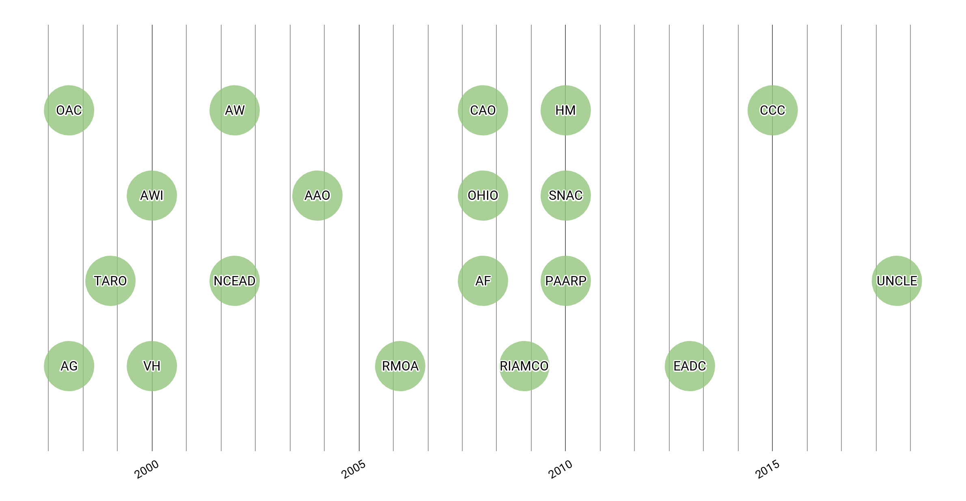
Timeline of Aggregator and Meta-Aggregator Founding
Notes:
Comments: Let’s have a look at the last twenty years. We see two general clusters of aggregators forming, one around 2000, a second in 2008-2010, and just a handful started in recent years.

Slide 13
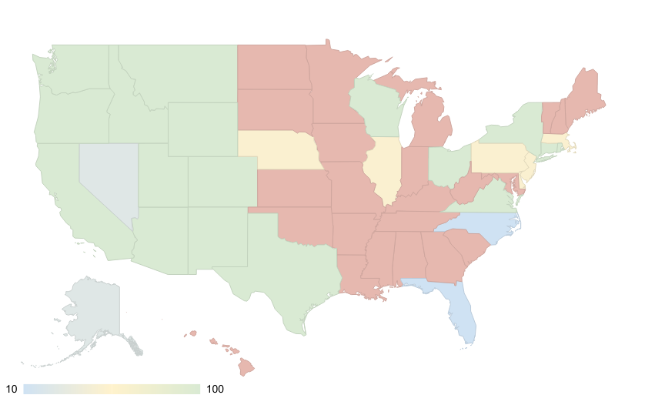
Access to State or Regional Aggregator
Repositories in half of U.S. states have access to an aggregator
Notes:
The western US is very well aggregated. The eastern seaboard is mixed (and includes two defunct aggregations), and a vast swath of the Midwest is left out.
Green: Aggregator open to all, and one or more institutions in the state participate
Yellow: Aggregator open to a limited number of participants
Blue: Aggregator was present at one time but is not now
Grey: Aggregator open to institutions in that state, but institutions do not participate
Red: No access to an aggregator

Slide 14
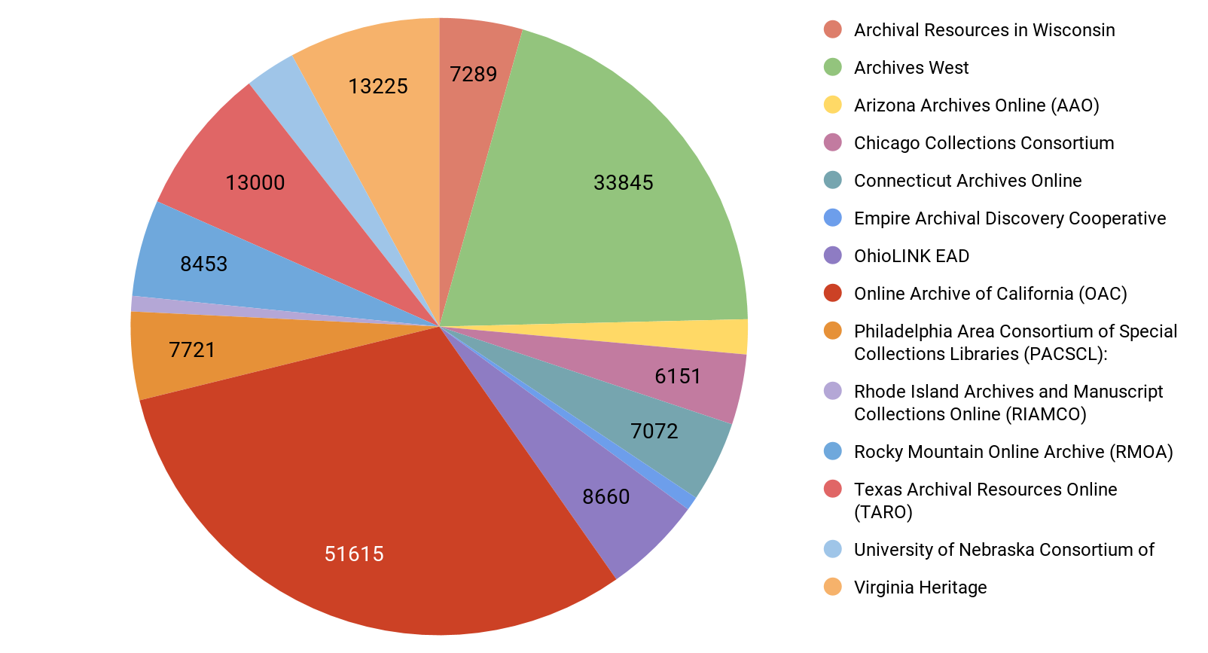
Aggregators provide persistent hosting for significant numbers of EAD finding aids in the U.S.
Number of Records Per Aggregator
Aggregators host 127,516 EAD finding aids and 39,563 other records
ArchiveGrid includes 195,659 EAD finding aids
There is significant known (but not quantified) overlap
Notes:
Numbers of records
May be the majority of the finding aids in structured format in the US
Ack role of NUCMC, not included in analysis

Slide 15
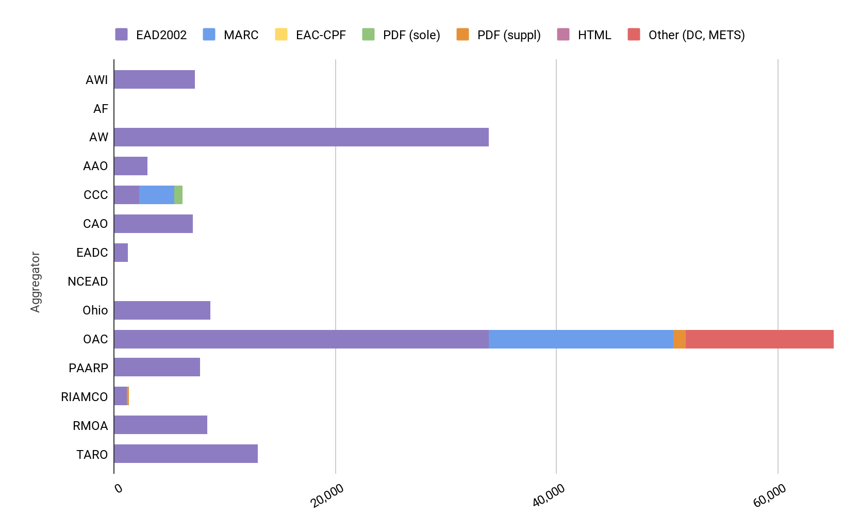
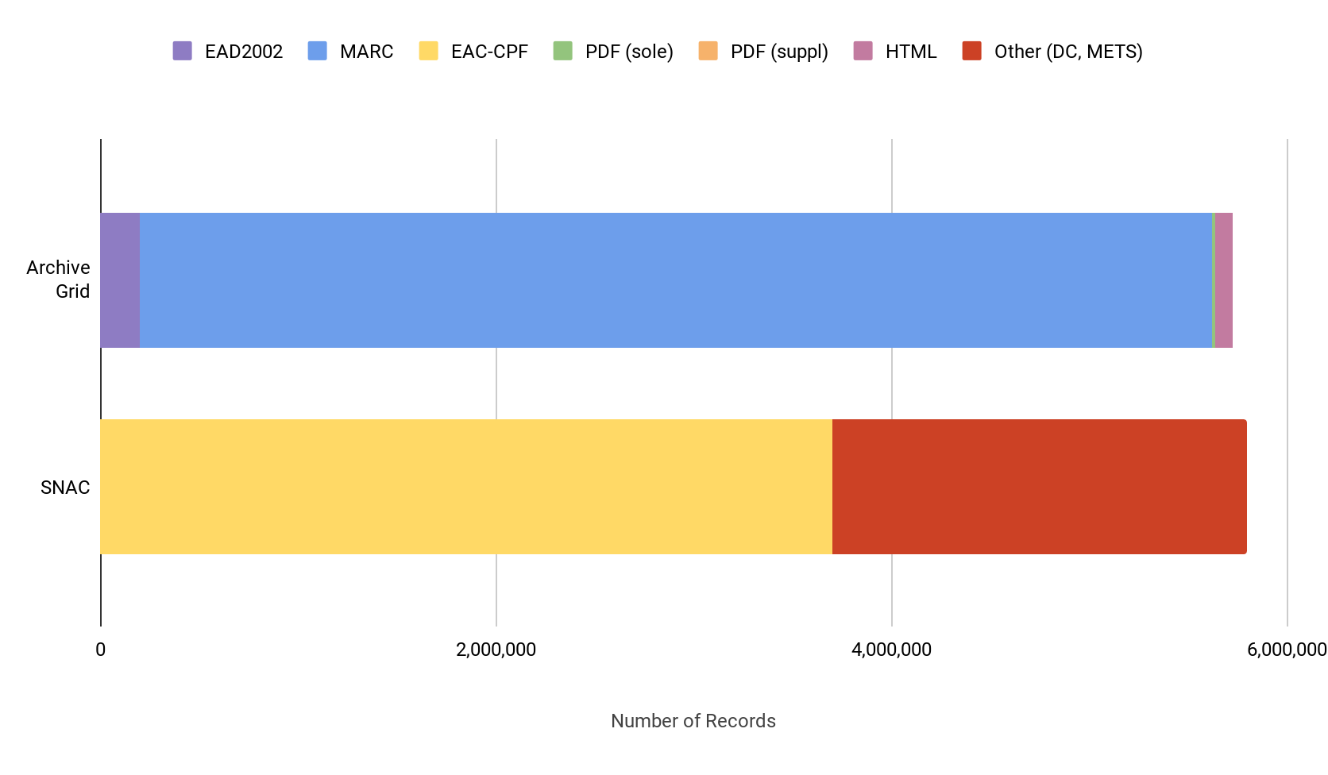
Aggregators host mostly EAD2002 (no EAD3)
Meta-aggregators have mostly MARC and EAC-CPF
Formats Hosted by Aggregators
Formats Hosted by Meta-Aggregators
Notes:
Types of records, no EAD3

Slide 16
Value proposition
Biggest value: Expose and facilitate search across collections at small or less well-known institutions and to reunite dispersed collections
Strong shared ethics around open and equitable access
Few have invested significantly in understanding their user audiences, and how they are changing
For most contributing institutions, simple and utility-like infrastructure is adequate
A smaller group is “champing at the bit” for innovation (LOD, etc.)

Slide 17
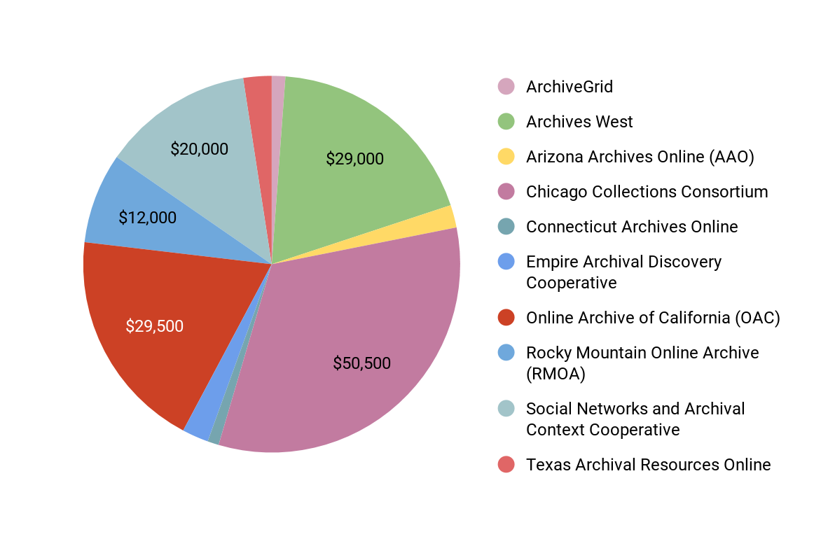
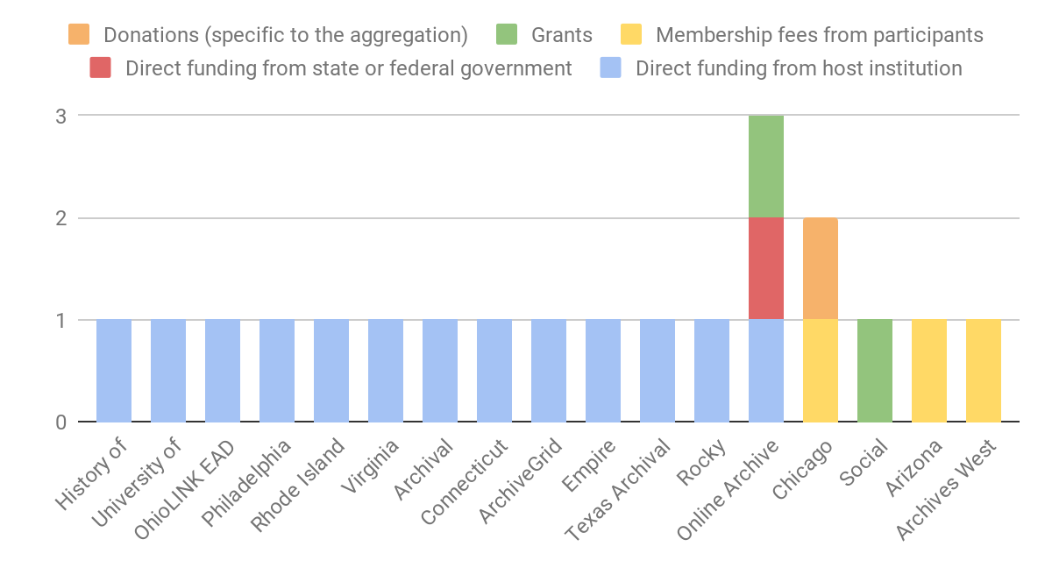
Current Resources are Scarce
Sources Depend on Host Institutions
Annual Aggregator and Meta-Aggregator Budgets
Budget Sources
Notes:
Only ten aggregators and meta-aggregators had identified budgets to support the aggregation.
The sources of those budgets are overwhelmingly the host institutions--convenient, but also vulnerable. Only three aggregations are supported in part or wholly by membership fees, and one meta-aggregation is wholly grant funded.

Slide 18
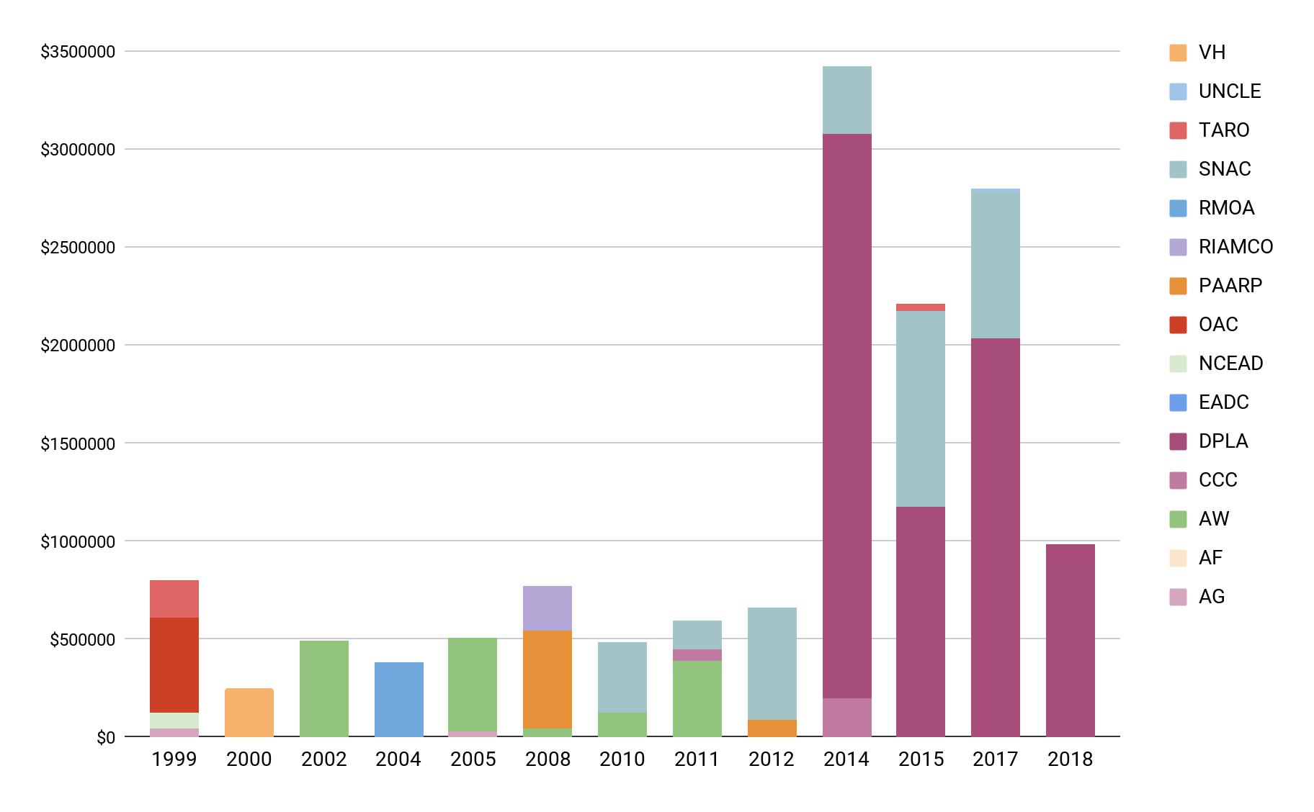
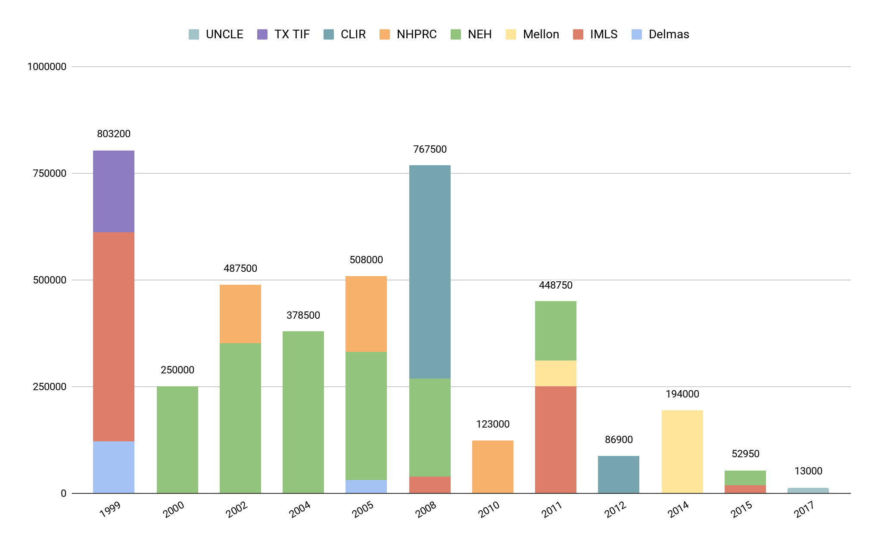
Grant Investment was Significant
But Recent Focus is for Meta-Aggregation
Grant Funding by Year, 1999-2018
(without SNAC)
Grant Funding for Aggregators and Meta-Aggregators, 1999-2018
(includes SNAC and DPLA)
Notes:
Grant funding started, but has not sustained, many aggregations
...but meta-aggregation relies on persistent hosting that is largely provided by aggregators.

Slide 19
Conclusions
It’s time to take stock of the aggregation model as a community
We need to become more user-centered
It’s time to consider how we can work together toward a robust, sustainable infrastructure that broadens access to collections
We have a deep commitment to providing persistent and high quality access to archival collections regardless of which institution holds them

Slide 20
Symposium
Notes:
Full-day symposium in June at UC Riverside with all core partners and advisers
Objectives
High level conclusions

Slide 21
Do we continue archival description/finding aid aggregation as is, or do something new and larger scale?
Notes:
Here was our question of the day: Do we continue as is, or do it differently --and better?

Slide 22
Discussions
Sustainable resourcing: What creates conditions for sustainability?
Value: What is the present value of aggregation? What could be the value?
Requirements: What is needed to meet the requirements we identified in Value?

Slide 23
Status Quo is Risky
Users can’t find what they need
Aggregations are organizationally and financially fragile
If aggregations fail, we may lose archival descriptions in which institutions, aggregators, and funders have invested substantial resources
We’d do it differently
if we could

Slide 24
We Chose Action!
Near term: Sustain the value that archival description aggregation currently provides by promoting inter-aggregator collaboration.
Save the metadata!
Longer term: Take transformative action to provide the value that the current approach does not provide.
Provide entry points to resources in the United States that that integrated description, content, and context
Work with all description levels, from item to repository
Develop shared infrastructure
Notes:
So what we are proposing is a massive and transformative collaborative effort.

Slide 25
Requirements
Serve End Users
Involve end users to shape creation and development
Support discovery that gets end users as close to the full resource as possible
Provide access that is about rather than where
Be Inclusive and Comprehensive
Recognize the value of under-represented collections
Provide end user service that is of value for better-resourced institutions
Reduce Local Work
Support low barriers to entry by
Taking many forms of existing metadata
Integrating with related tools
Automating contribution processes
Setting minimal (but strict) requirements

Slide 26
Action Plan Complete by September 30, 2019

Slide 27
Thank you!
Jodi Allison-Bunnell, AB Consulting, http://consulting.allison-bunnell.net
Adrian Turner, California Digital Library, Adrian.Turner@ucop.edu

